Slide 1
Chapter 6: Formal Relational Query Languages

Slide 2
Chapter 6: Formal Relational Query Languages
Relational Algebra
Fundamental Operations
  select: σ
  project: ∏
  union: ∪
  set difference: –
  Cartesian product: x
  rename: ρ
Additional Operations
  Set intersection: ∩
  Natural join:
  Assignment: ←
  Outer join:
Extended Relational Algebra Expressions
  Generalized Projection
  Aggregate Functions

Slide 3
Relational Algebra
The relational algebra is a procedural query language.
It consists of a set of operations that take one or two relations as input and produce a new relation as their result.
Six fundamental (basic) operations are:
  select: σ
  project: ∏
  union: ∪
  set difference: –
  Cartesian product: x
  rename: ρ
Unary operations: Operate on one relation – select, project and rename
Binary operations: Operate on pairs of relations – union, set difference and Cartesian product

Slide 4

Select Operation – Example
Relation r
σ_{A=B ^ D > 5} (r)

Slide 5
Select Operation
The select operation selects tuples that satisfy a given predicate.
The lowercase Greek letter sigma (σ) is used to denote selection.
The predicate appears as a subscript to σ.
The argument relation is in parentheses after the σ.
Notation: σ _{p}(r), p is called the selection predicate
Defined as:
σ_{p}(r) = {t | t ∈ r and p(t)}
Where p is a formula in propositional calculus consisting of terms connected by : ∧ (and), ∨ (or), ¬ (not)
Each term is one of:
<attribute> op <attribute> or <constant>
where op is one of: =, ≠, >, ≥. <. ≤
Example of selection:
σ _{dept_name=“Physics”}(instructor)

Slide 6
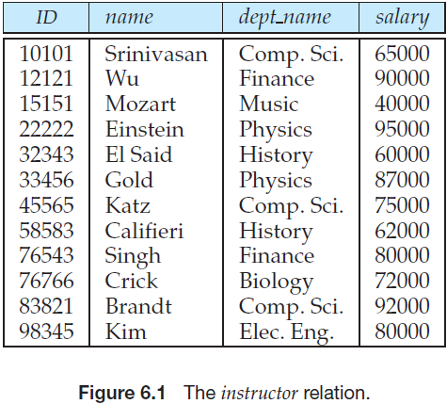
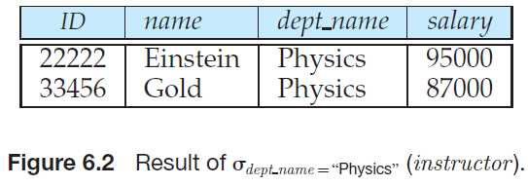
Select Operation

Slide 7
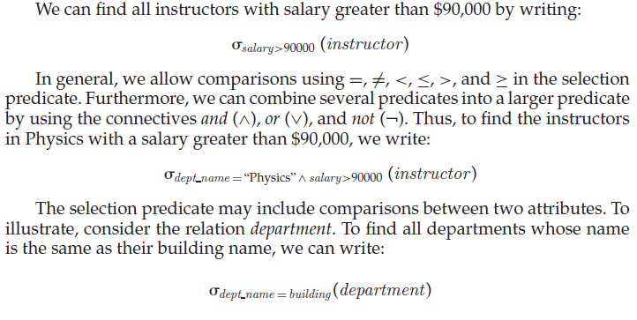
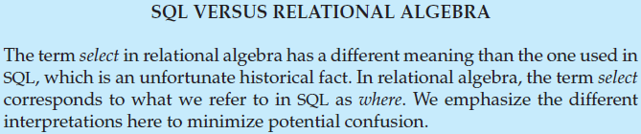
Select Operation

Slide 8

Project Operation – Example
Relation r:
∏_{A,C} (r)

Slide 9

Project Operation
The project operation is a unary operation that returns its argument relation, with certain attributes left out.
Since a relation is a set, any duplicate rows are eliminated.
Projection is denoted by the uppercase Greek letter pi (∏). We list those attributes that we wish to appear in the result as a subscript to ∏.
The argument relation follows in parentheses.
Notation:
where A₁, A₂ are attribute names and r is a relation name.
The result is defined as the relation of k columns obtained by erasing the columns that are not listed
Example: To eliminate the dept_name attribute of instructor
∏_{ID, name, salary} (instructor)

Slide 10
Composition of Relational Operations
“Find the name of all instructors in the Physics department.” We write:
∏ _{name}(σ _{dept_name=“Physics”}(instructor))
Notice that, instead of giving the name of a relation as the argument of the projection operation, an expression is given that evaluates to a relation.
In general, since the result of a relational-algebra operation is of the same type (relation) as its inputs, relational-algebra operations can be composed together into a relational-algebra expression.
Composing relational-algebra operations into relational-algebra expressions is just like composing arithmetic operations (such as +,−, ∗, and ÷) into arithmetic expressions.

Slide 11

Union Operation – Example
Relations r, s:
r ∪ s:

Slide 12
Union Operation
Notation: r ∪ s
Defined as:
r ∪ s = {t | t ∈ r or t ∈ s}
For r ∪ s to be valid.
1. r, s must have the same arity (same number of attributes)
2. The attribute domains must be compatible (example: 2nd column
of r deals with the same type of values as does the 2nd
column of s)
Note that r and s can be either database relations or temporary relations that are the result of relational-algebra expressions.
Example: to find all courses taught in the Fall 2009 semester, or in the Spring 2010 semester, or in both
∏_{course_id} (σ _{semester=“Fall” Λ year=2009} (section)) ∪
∏_{course_id} (σ _{semester=“Spring” Λ year=2010} (section))

Slide 13

Set difference of two relations
Relations r, s:
r – s:

Slide 14
Set Difference Operation
The set-difference operation, denoted by −, allows us to find tuples that are in one relation but are not in another.
The expression r − s produces a relation containing those tuples in r but not in s.
Defined as:
r – s = {t | t ∈ r and t ∉ s}
Set differences must be taken between compatible relations.
  r and s must have the same arity
  attribute domains of r and s must be compatible
As with the union operation, we must ensure that set differences are taken between compatible relations.
Example: to find all courses taught in the Fall 2009 semester, but not in the Spring 2010 semester
∏_{course_id} (σ _{semester=“Fall” Λ year=2009} (section)) −
∏_{course_id} (σ _{semester=“Spring” Λ year=2010} (section))

Slide 15

Cartesian-Product Operation – Example
Relations r, s:
r x s:

Slide 16
Cartesian-Product Operation
The Cartesian-product operation, denoted by a cross (×), allows us to combine information from any two relations.
We write the Cartesian product of relations r1 and r2 as r1 × r2.
Notation r x s
Defined as:
r x s = {t q | t ∈ r and q ∈ s}
Assume that attributes of r(R) and s(S) are disjoint. (That is, R ∩ S = ∅).
If attributes of r(R) and s(S) are not disjoint, then renaming must be used.

Slide 17

Composition of Operations
Can build expressions using multiple operations
Example: σ_{A=C}(r x s)
r x s
σ_{A=C}(r x s)

Slide 18
Example Queries
Find the names of all instructors in the Physics department, along with the course_id of all courses they have taught
  Query 1
  ∏_{instructor.ID,course_id} (σ_{dept_name=“Physics”} (
  σ _{instructor.ID=teaches.ID} (instructor x teaches)))
  Query 2
  ∏_{instructor.ID,course_id} (σ_{instructor.ID=teaches.ID} (
  σ _{dept_name=“Physics”} (instructor) x teaches))
  Query 3
  ∏_{instructor.ID,course_id} (σ_{dept_name=“Physics” ^}
  σ _{instructor.ID=teaches.ID} (instructor x teaches))

Slide 19

Rename Operation
Allows us to name, and therefore to refer to, the results of relational-algebra expressions.
Allows us to refer to a relation by more than one name.
Example:
ρ _{x} (E)
returns the expression E under the name X
If a relational-algebra expression E has arity n, then
returns the result of expression E under the name X, and with the
attributes renamed to A₁ , A₂ , …., A_{n} .

Slide 20
Example Query
Find the largest salary in the university
  Step 1: find instructor salaries that are less than some other instructor salary (i.e. not maximum)
      using a copy of instructor under a new name d
    ∏_{instructor.salary} (σ _{instructor.salary < d.salary}
    (instructor x ρ_{d} (instructor)))
  Step 2: Find the largest salary
    ∏_{salary} (instructor) –
    ∏_{instructor.salary} (σ _{instructor.salary < d,salary}
    (instructor x ρ_{d} (instructor)))

Slide 21
Formal Definition
A basic expression in the relational algebra consists of either one of the following:
  A relation in the database
  A constant relation
Exmp. { (22222, Einstein, Physics, 95000), (76543, Singh, Finance, 80000) }
Let E₁ and E₂ be relational-algebra expressions; the following are all relational-algebra expressions:
  E₁ ∪ E₂
  E₁ – E₂
  E₁ x E₂
  σ_{p} (E₁), P is a predicate on attributes in E₁
  ∏_{s}(E₁), S is a list consisting of some of the attributes in E₁
  ρ _{x} (E₁), x is the new name for the result of E₁

Slide 22
Additional Operations
The fundamental operations of the relational algebra are sufficient to express any relational-algebra query.
However, if we restrict ourselves to just the fundamental operations, certain common queries are lengthy to express.
Therefore, we define additional operations that do not add any power to the algebra, but simplify common queries.
We define additional operations that do not add any power to the relational algebra, but that simplify common queries.
  Set intersection
  Natural join
  Assignment
  Outer join

Slide 23

Set-Intersection Operation – Example
Relation r, s:
r ∩ s

Slide 24
Set-Intersection Operation
Notation: r ∩ s
Defined as: r ∩ s = { t | t ∈ r and t ∈ s }
Assume:
  r, s have the same arity
  attributes of r and s are compatible
Note: set intersection is not a fundamental operation. Thus, we can rewrite any relational-algebra expression that uses set intersection by replacing the intersection operation with a pair of set-difference operations as:
r ∩ s = r – (r – s)
It is simply more convenient to write r ∩ s than to write r – (r – s)
Example: to find all courses taught in both the Fall 2009 semester and the Spring 2010 semester
∏_{course_id} (σ _{semester=“Fall” Λ year=2009} (section)) ∩
∏_{course_id} (σ _{semester=“Spring” Λ year=2010} (section))

Slide 25

Natural Join Example
Relations r, s:
r s

Slide 26
Natural-Join Operation
Notation: r s
Let r and s be relations on schemas R and S respectively.
Then, r s is a relation on schema R ∪ S obtained as follows:
  Consider each pair of tuples t_{r} from r and t_{s} from s.
  If t_{r} and t_{s} have the same value on each of the attributes in R ∩ S, add a tuple t to the result, where
    t has the same value as t_{r} on r
    t has the same value as t_{s} on s
Example:
  R = (A, B, C, D)
  S = (E, B, D)
  Result schema = (A, B, C, D, E)
  r s is defined as:
  ∏_{r.A, r.B, r.C, r.D, s.E} (σ_{r.B = s.B ∧ r.D = s.D} (r x s))

Slide 27
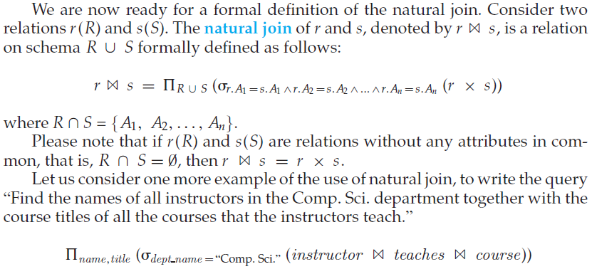
Natural-Join Operation

Slide 28
Natural-Join Operation
It is often desirable to simplify certain queries that require a Cartesian product. Usually, a query that involves a Cartesian product includes a selection operation on the result of the Cartesian product.
The selection operation most often requires that all attributes that are common to the relations that are involved in the Cartesian product be equated.
The natural join is a binary operation that allows us to combine certain selections and a Cartesian product into one operation.
How it works?
1. The natural-join operation forms a Cartesian product of its two arguments,
2. Performs a selection forcing equality on those attributes that appear in both relation schemas, and finally
3. Removes duplicate attributes.
Example: To find the names of all instructors together with the course_id of all courses they taught
∏_{name,} _{course_id} (instructor teaches)

Slide 29
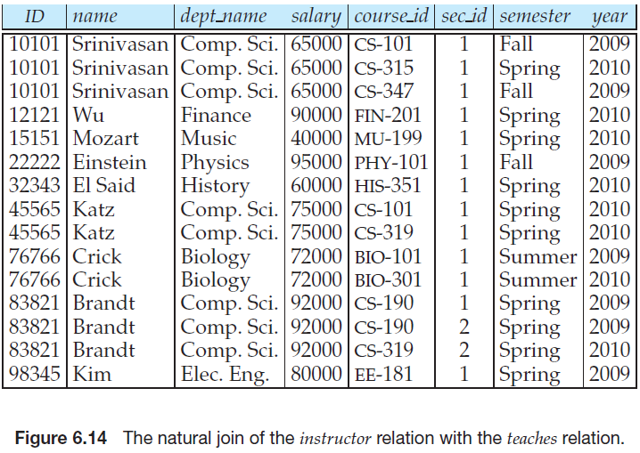
Natural Join Operation

Slide 30
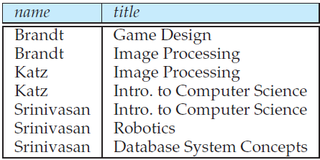
Natural Join Operation
Find the names of all instructors in the Comp. Sci. department together with the course titles of all the courses that the instructors teach
  ∏ _{name, title} (σ _{dept_name=“Comp. Sci.”} (instructor teaches course))
Natural join is associative
  (instructor teaches) course is equivalent to
  instructor (teaches course)
Natural join is commutative
  instruct teaches is equivalent to
  teaches instructor

Slide 31
Natural Join and Theta Join
The theta join operation is a variant of the natural-join operation that allows us to combine a selection and a Cartesian product into a single operation.
Consider relations r (R) and s(S), and let be a predicate on attributes in the schema R ∪ S.
The theta join operation r _{θ} s is defined as
  r _{θ} s = σ_{θ} (r x s)

Slide 32

Assignment Operation
It is convenient at times to write a relational-algebra expression by assigning parts of it to temporary relation variables.
The assignment operation, denoted by ←, works like assignment in a programming language. To illustrate this operation, consider the definition of the natural-join operation. We could write r s as:
An assignment does not result in any relation being displayed to the user. Rather, the result of the expression to the right of the ← is assigned to the relation variable on the left of the ←. This relation variable may be used in subsequent expressions.

Slide 33
Assignment Operation
With the assignment operation, a query can be written as a sequential program consisting of a series of assignments followed by an expression whose value is displayed as the result of the query.
For relational-algebra queries, assignment must always be made to a temporary relation variable. Assignments to permanent relations constitute a database modification.
Note that the assignment operation does not provide any additional power to the algebra. It is, however, a convenient way to express complex queries.

Slide 34
Outer Join
The outer-join operation is an extension of the join operation to deal with missing information (avoids loss of information).
Computes the join and then adds tuples form one relation that does not match tuples in the other relation to the result of the join.
Suppose that there is some instructor who teaches no courses. Using natural join some tuples in either or both of the relations being joined may be “lost” in this way.
The outer join operation preserves those tuples that would be lost in an join by creating tuples in the result containing null values.
Uses null values:
  null signifies that the value is unknown or does not exist
  All comparisons involving null are (roughly speaking) false by definition.
There are actually three forms of the operation: 1. left outer join, 2. right outer join; and 3. full outer join.

Slide 35
Outer Join – Example
Relation instructor1
ID
name
dept_name
10101
12121
15151
Srinivasan
Wu
Mozart
Comp. Sci.
Finance
Music
Relation teaches1
ID
course_id
10101
12121
76766
CS-101
FIN-201
BIO-101

Slide 36
Outer Join – Example
Natural Join
instructor teaches
ID
name
dept_name
course_id
10101
12121
Srinivasan
Wu
Comp. Sci.
Finance
CS-101
FIN-201
Left Outer Join
instructor teaches
ID
name
dept_name
course_id
10101
12121
15151
Srinivasan
Wu
Mozart
Comp. Sci.
Finance
Music
CS-101
FIN-201
null

Slide 37
Outer Join – Example
Right Outer Join
instructor teaches
ID
name
dept_name
course_id
10101
12121
76766
Srinivasan
Wu
null
Comp. Sci.
Finance
null
CS-101
FIN-201
BIO-101
Full Outer Join
instructor teaches
ID
name
dept_name
course_id
10101
12121
15151
76766
Srinivasan
Wu
Mozart
null
Comp. Sci.
Finance
Music
null
CS-101
FIN-201
null
BIO-101

Slide 38
Outer Join using Joins
Outer join can be expressed using basic operations
1. Left outer join
r s = (r s) U (r – ∏_{R} (r s)) X {(null, null, …., null)}, where the constant relation in on schema S – R.
2. Right outer join
r s = (r s) U (s – ∏_{S} (r s)) X {(null, null, …., null)}, where the constant relation in on schema R – S.
3. Full outer join
r s = (r s) U (r – ∏_{R} (r s)) X {(null, null, …., null)} U (s – ∏_{S} (r s)) X {(null, null, …., null)}

Slide 39
Null Values
It is possible for tuples to have a null value, denoted by null, for some of their attributes
null signifies an unknown value or that a value does not exist.
The result of any arithmetic expression involving null is null.
Aggregate functions simply ignore null values (as in SQL)
For duplicate elimination and grouping, null is treated like any other value, and two nulls are assumed to be the same (as in SQL)

Slide 40
Null Values
Comparisons with null values return the special truth value: unknown
  If false was used instead of unknown, then not (A < 5)
  would not be equivalent to A >= 5
Three-valued logic using the truth value unknown:
  OR: (unknown or true) = true,
  (unknown or false) = unknown
  (unknown or unknown) = unknown
  AND: (true and unknown) = unknown,
  (false and unknown) = false,
  (unknown and unknown) = unknown
  NOT: (not unknown) = unknown
  In SQL “P is unknown” evaluates to true if predicate P evaluates to unknown
Result of select predicate is treated as false if it evaluates to unknown

Slide 41
Extended Relational-Algebra-Operations
The relational-algebra operations that provide the ability to write queries that cannot be expressed using the basic relational-algebra operations.
These operations are called extended relational-algebra operations. These are:
  Generalized Projection
  Aggregate Functions

Slide 42
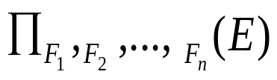
Generalized Projection
Extends the projection operation by allowing operations such as arithmetic and string functions to be used in the projection list.
The generalized-projection operation has the form:
where
a. E is any relational-algebra expression
b. Each of F₁, F₂, …, F_{n} are arithmetic expressions involving constants and attributes in the schema of E.
As a base case, the expression may be simply an attribute or a constant. In general, an expression can use arithmetic operations such as +,−, ∗, and ÷ on numeric valued attributes, numeric constants, and on expressions that generate a numeric result. Generalized projection also permits operations on other data types, such as concatenation of strings.
Given relation instructor(ID, name, dept_name, salary) where salary is annual salary, get the same information but with monthly salary
∏_{ID, name, dept_name, salary/12} (instructor)

Slide 43


Aggregate Functions and Operations
Aggregation function takes a collection of values and returns a single value as a result.
avg: average value
min: minimum value
max: maximum value
sum: sum of values
count: number of values
Aggregate operation in relational algebra
E is any relational-algebra expression
  G₁, G₂ …, G_{n} is a list of attributes on which to group (can be empty)
  Each F_{i} is an aggregate function
  Each A_{i} is an attribute name
Note: Some books/articles use γ instead of (Calligraphic G)

Slide 44
Aggregate Operation – Example
Relation r:
A
B
C
α
α
β
β
α
β
β
β
7
7
3
10
_{sum(c)} (r)
sum(c )
27

Slide 45


Aggregate Operation – Example
The collections on which aggregate functions operate can have multiple occurrences of a value; the order in which the values appear is not relevant. Such collections are called multisets. Sets are a special case of multisets where there is only one copy of each element.
Find the average salary in each department
_{dept_name} _{avg(salary)} (instructor)
avg_salary

Slide 46
Aggregate Functions (Cont.)
Result of aggregation does not have a name
  Can use rename operation to give it a name
  For convenience, we permit renaming as part of aggregate operation
There are cases where we must eliminate multiple occurrences of a value before computing an aggregate function.
Find the total number of instructors who teach a course in the Spring 2010 semester.
count−distinct(ID)(σ semester=“Spring”∧ year = 2010 (teaches))
_{dept_name} _{avg(salary) as avg_sal} (instructor)

Slide 47
Multiset Relational Algebra
Pure relational algebra removes all duplicates
  e.g. after projection
Multiset relational algebra retains duplicates, to match SQL semantics
  SQL duplicate retention was initially for efficiency, but is now a feature
Multiset relational algebra defined as follows
  selection: has as many duplicates of a tuple as in the input, if the tuple satisfies the selection
  projection: one tuple per input tuple, even if it is a duplicate
  cross product: If there are m copies of t1 in r, and n copies of t2 in s, there are m x n copies of t1.t2 in r x s
  Other operators similarly defined
    E.g. union: m + n copies, intersection: min(m, n) copies
    difference: min(0, m – n) copies

Slide 48
SQL and Relational Algebra
select A1, A2, .. An
from r1, r2, …, rm
where P
is equivalent to the following expression in multiset relational algebra
∏ _{A1, .., An} (σ _{P} (r1 x r2 x .. x rm))
select A1, A2, sum(A3)
from r1, r2, …, rm
where P
group by A1, A2
is equivalent to the following expression in multiset relational algebra
_{A1, A2} _{sum(A3)} (σ _{P} (r1 x r2 x .. x rm)))

Slide 49
SQL and Relational Algebra
More generally, the non-aggregated attributes in the select clause may be a subset of the group by attributes, in which case the equivalence is as follows:
select A1, sum(A3)
from r1, r2, …, rm
where P
group by A1, A2
is equivalent to the following expression in multiset relational algebra
∏ _{A1,sumA3}( _{A1,A2} _{sum(A3)} _{as sumA3}(σ _{P} (r1 x r2 x .. x rm)))

Slide 50
Modification of the Database
The content of the database may be modified using the following operations:
  Deletion
  Insertion
  Updating
All these operations can be expressed using the assignment operator

Slide 51
Deletion
A delete request is expressed similarly to a query, except instead of displaying tuples to the user, the selected tuples are removed from the database.
Can delete only whole tuples; cannot delete values on only particular attributes
A deletion is expressed in relational algebra by:
r ← r – E
where r is a relation and E is a relational algebra query.

Slide 52
Deletion Examples
Delete all account records in the Perryridge branch.
account ← account – σ _{branch_name = “Perryridge”} (account )
Delete all loan records with amount in the range of 0 to 50
loan ← loan – σ _{amount ≥ 0 and amount ≤ 50} (loan)
Delete all accounts at branches located in Needham.
r₁ ← σ _{branch_city = “Needham”} (account branch )
r₂ ← ∏ _{account_number,} _{branch_name, balance} (r₁)
r₃ ← ∏ _{customer_name, account_number} (r₂ depositor)
account ← account – r₂
depositor ← depositor – r₃

Slide 53
Insertion
To insert data into a relation, we either:
  specify a tuple to be inserted
  write a query whose result is a set of tuples to be inserted
in relational algebra, an insertion is expressed by:
r ← r ∪ E
where r is a relation and E is a relational algebra expression.
The insertion of a single tuple is expressed by letting E be a constant relation containing one tuple.

Slide 54
Insertion Examples
Insert information in the database specifying that Smith has $1200 in account A-973 at the Perryridge branch.
account ← account ∪ {(“A-973”, “Perryridge”, 1200)}
depositor ← depositor ∪ {(“Smith”, “A-973”)}
Provide as a gift for all loan customers in the Perryridge
branch, a $200 savings account. Let the loan number serve
as the account number for the new savings account.
r₁ ← (σ_{branch_name = “Perryridge”} (borrower loan))
account ← account ∪ ∏_{loan_number, branch_name, 200} (r₁)
depositor ← depositor ∪ ∏_{customer_name, loan_number} (r₁)

Slide 55

Updating
A mechanism to change a value in a tuple without charging all values in the tuple
Use the generalized projection operator to do this task
Each F_{i} is either
  the I ^{th} attribute of r, if the I ^{th} attribute is not updated, or,
  if the attribute is to be updated F_{i} is an expression, involving only constants and the attributes of r, which gives the new value for the attribute

Slide 56
Update Examples
Make interest payments by increasing all balances by 5 percent.
account ← ∏ account_number, branch_name, balance * 1.05 (account)
Pay all accounts with balances over $10,000 6 percent interest
and pay all others 5 percent
account ← ∏ account_number, branch_name, balance * 1.06 (σ _{BAL > 10000} (account ))
∪ ∏ account_number, branch_name, balance * 1.05 (σ_{BAL ≤ 10000} (account))

Slide 57
Example Queries
Find the names of all customers who have a loan and an account at bank.
  ∏_{customer_name} (borrower) ∩ ∏_{customer_name} (depositor)
Find the name of all customers who have a loan at the bank and the loan amount
  ∏customer_name, loan_number, amount (borrower loan)

Slide 58
Example Queries
Find all customers who have an account from at least the “Downtown” and the Uptown” branches.
  Query 1
    ∏_{customer_name} (σ_{branch_name = “Downtown”} (depositor account )) ∩
    ∏_{customer_name} (σ_{branch_name = “Uptown”} (depositor account))
  Query 2
  ∏_{customer_name, branch_name} (depositor account)
  ÷ ρ_{temp(branch_name)} ({(“Downtown” ), (“Uptown” )})
  Note that Query 2 uses a constant relation.

Slide 59
Bank Example Queries
Find all customers who have an account at all branches located in Brooklyn city.
∏_{customer_name, branch_name} (depositor account)
÷ ∏_{branch_name} (σ_{branch_city = “Brooklyn”} (branch))

Slide 60
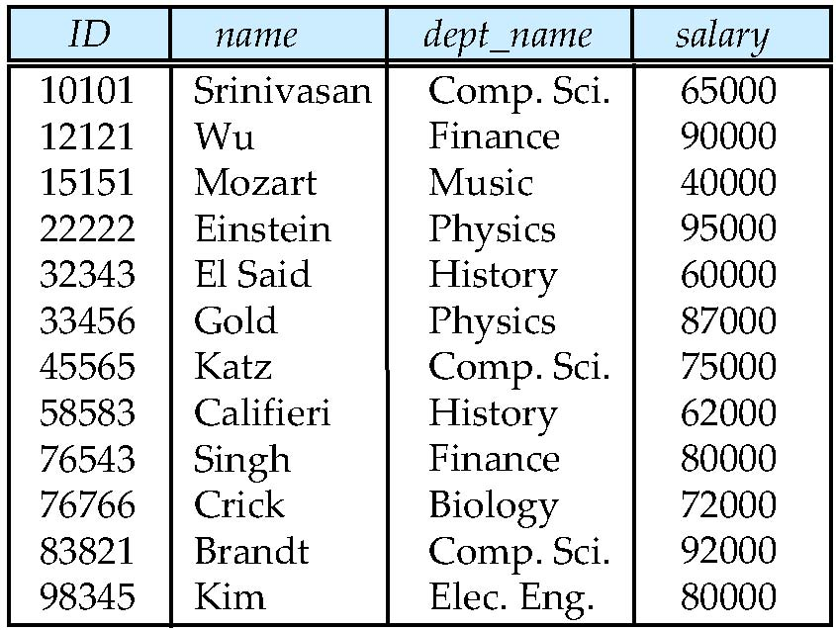
Figure 6.01

Slide 61
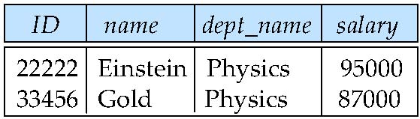
Figure 6.02

Slide 62
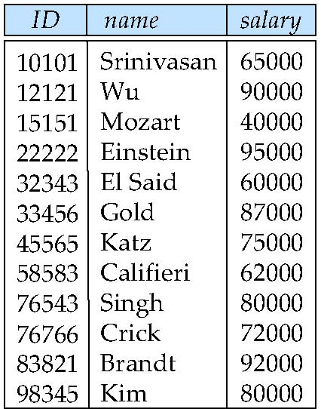
Figure 6.03

Slide 63

Figure 6.04

Slide 64
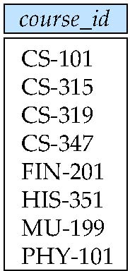
Figure 6.05

Slide 65
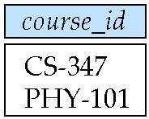
Figure 6.06

Slide 66
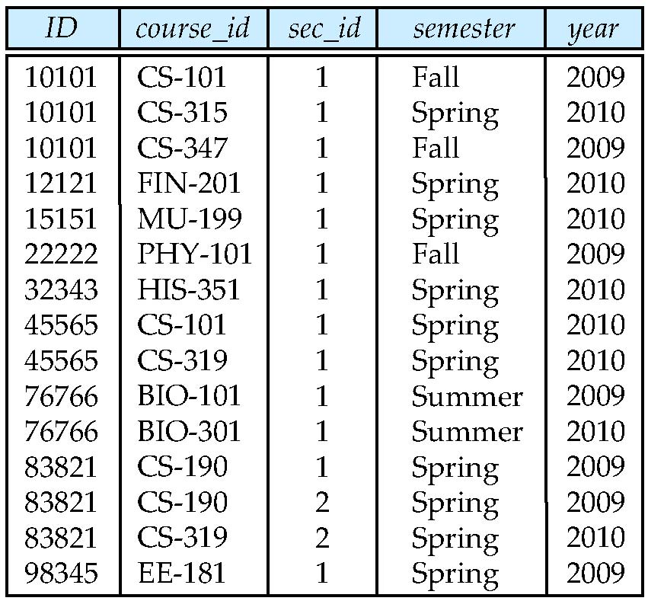
Figure 6.07

Slide 67
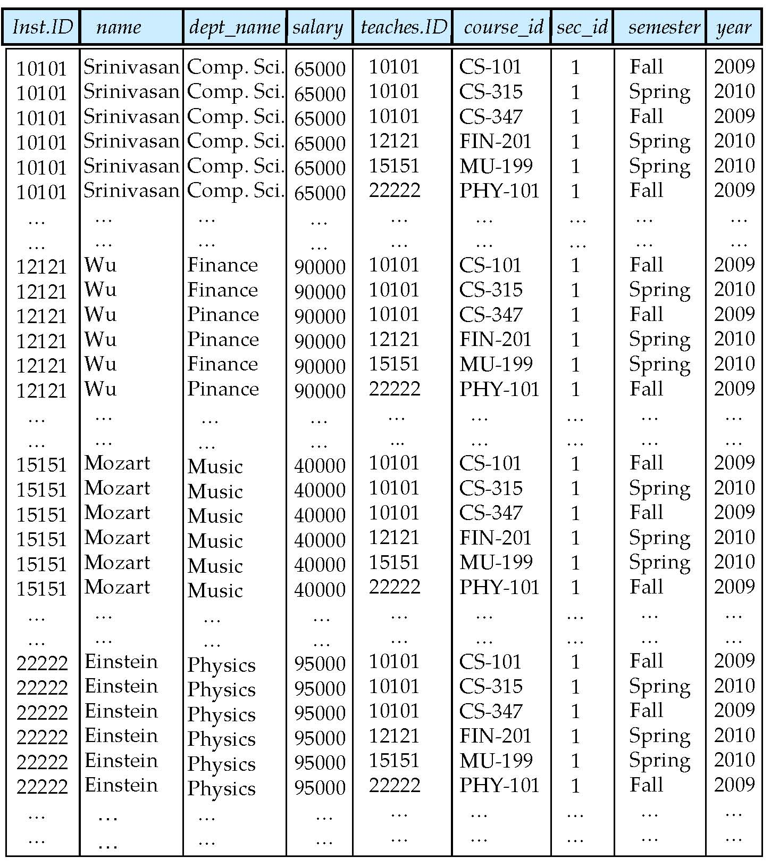
Figure 6.08

Slide 68
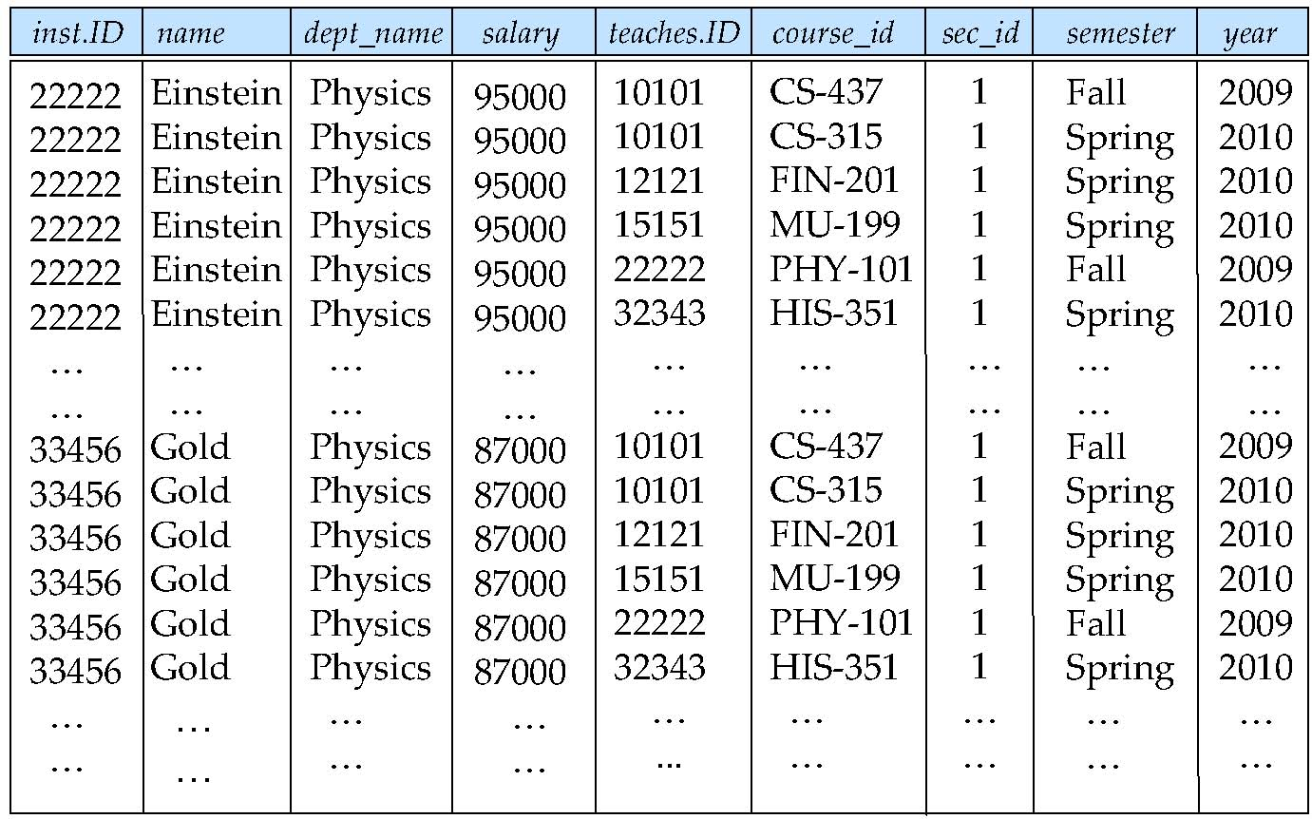
Figure 6.09

Slide 69
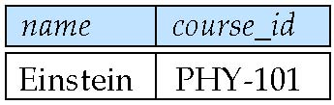
Figure 6.10

Slide 70
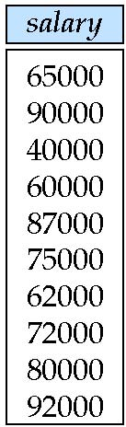
Figure 6.11

Slide 71
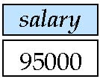
Figure 6.12

Slide 72
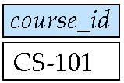
Figure 6.13

Slide 73

Figure 6.14

Slide 74
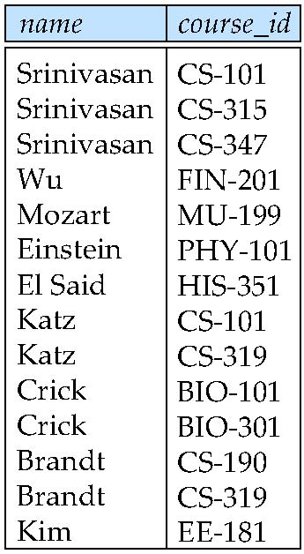
Figure 6.15

Slide 75
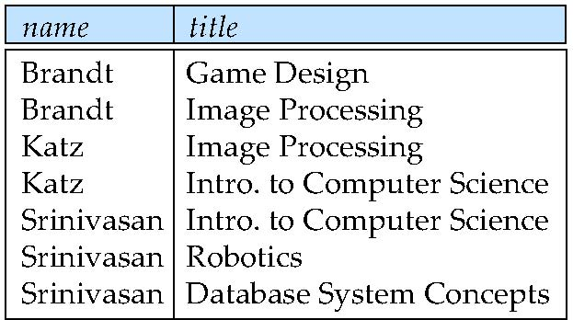
Figure 6.16

Slide 76
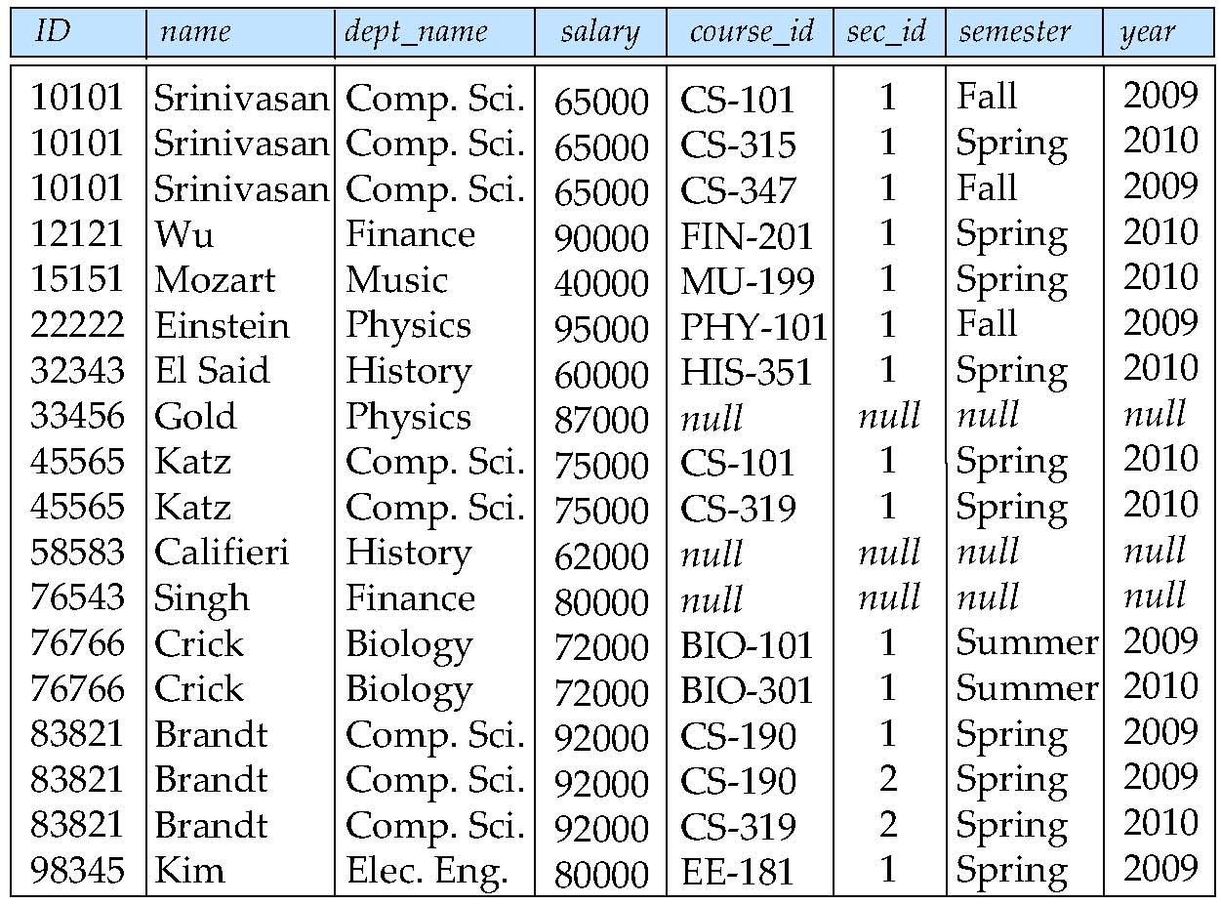
Figure 6.17

Slide 77
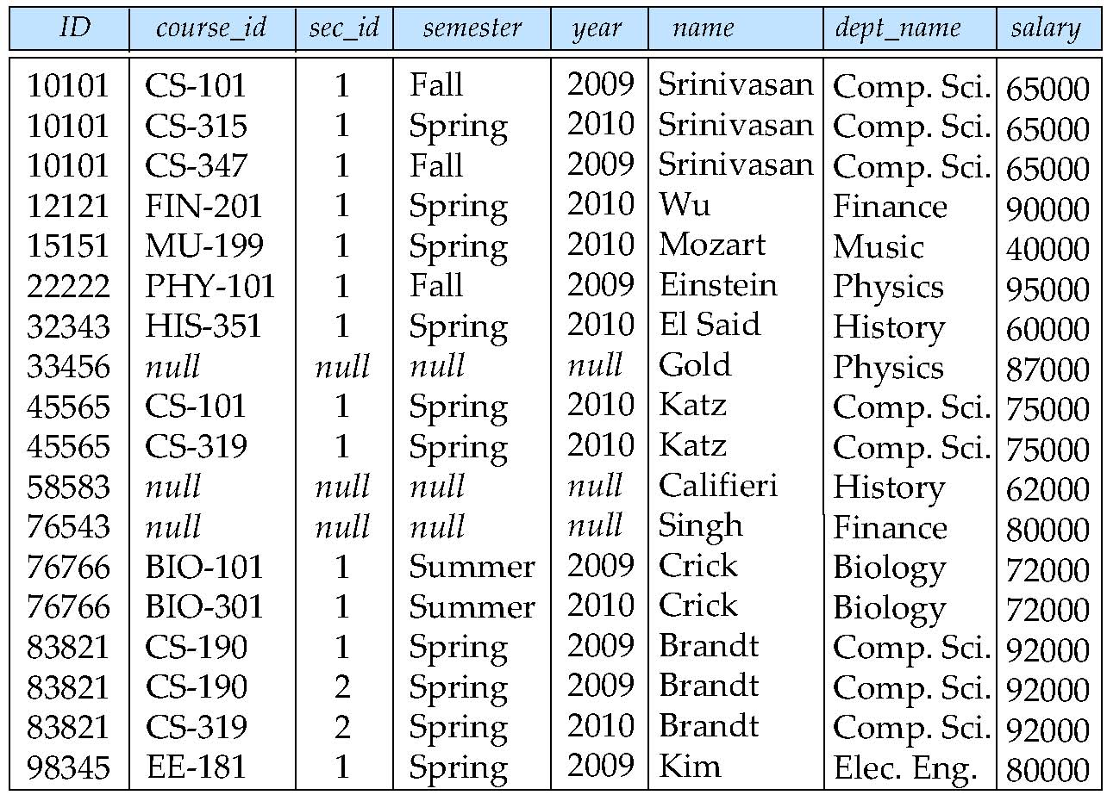
Figure 6.18

Slide 78

Figure 6.19

Slide 79
Figure 6.20

Slide 80
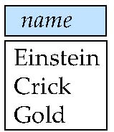
Figure 6.21

